Slide 2
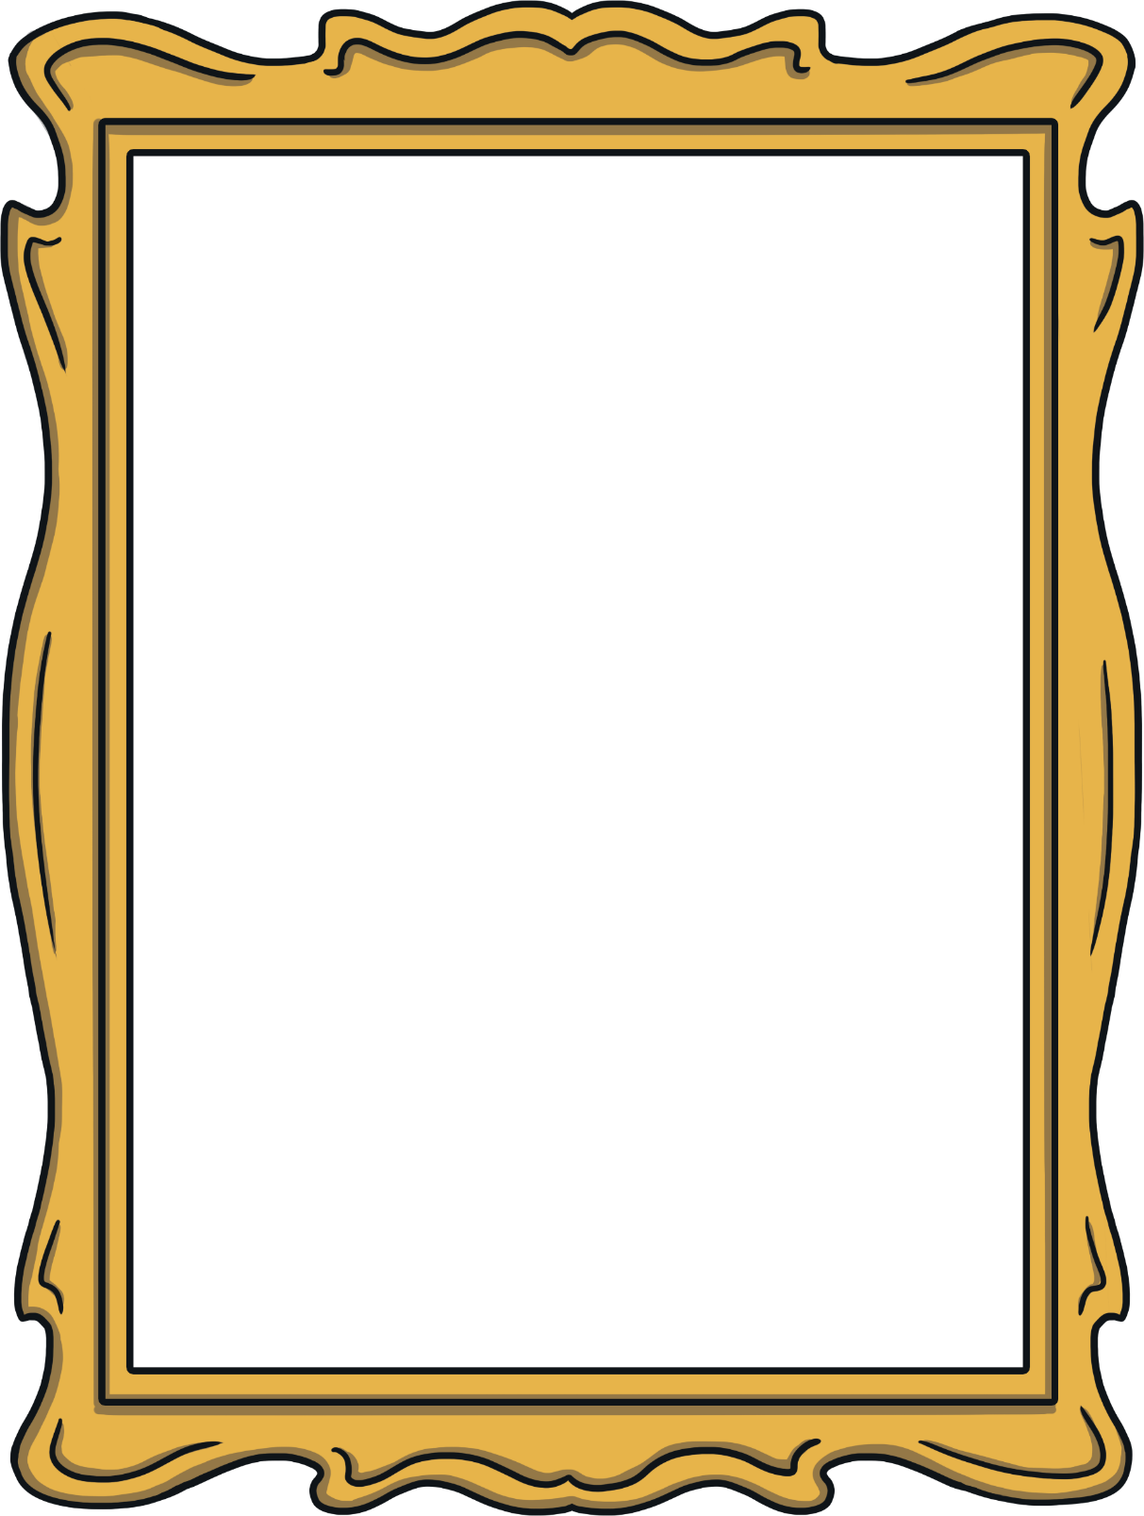
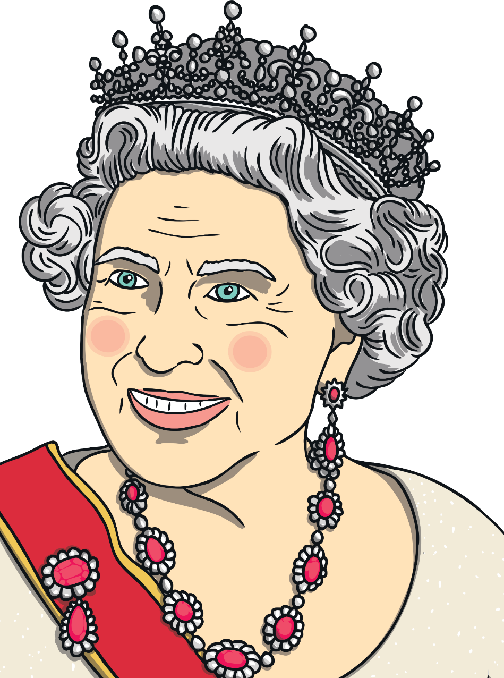
The Queen
The Queen’s name is Elizabeth Alexandra Mary.
Her royal title is Queen Elizabeth ΙΙ.
She is the head of the Royal Family.
She is the longest serving British monarch.
In 2022 she celebrates her Platinum Jubilee. She will have been Queen for 70 years.
She was married to Philip Mountbatten.
She has 4 children; Charles, Anne, Andrew and Edward.

Slide 3
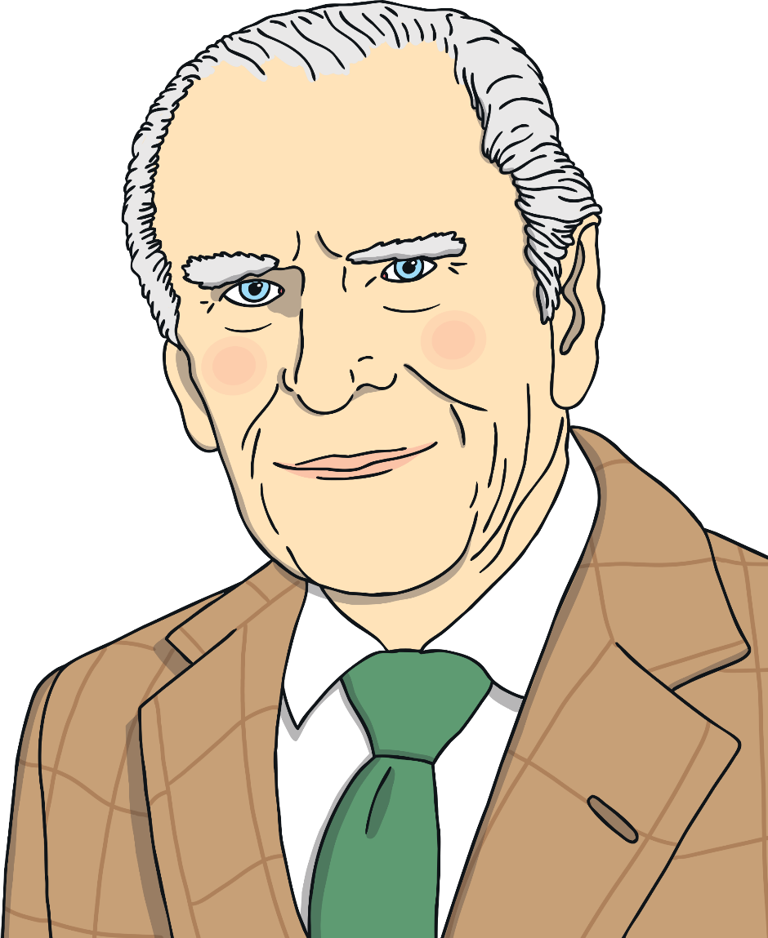
Prince Phillip
Prince Philip was the Queen’s husband.
His royal title was the Duke of Edinburgh.
His full name was Philip Mountbatten.
He lived to be 99 years old.
Philip was not the king. If he had been, he would outrank the Queen.
Philip could not be king because he was not born into the Royal Family.

Slide 4
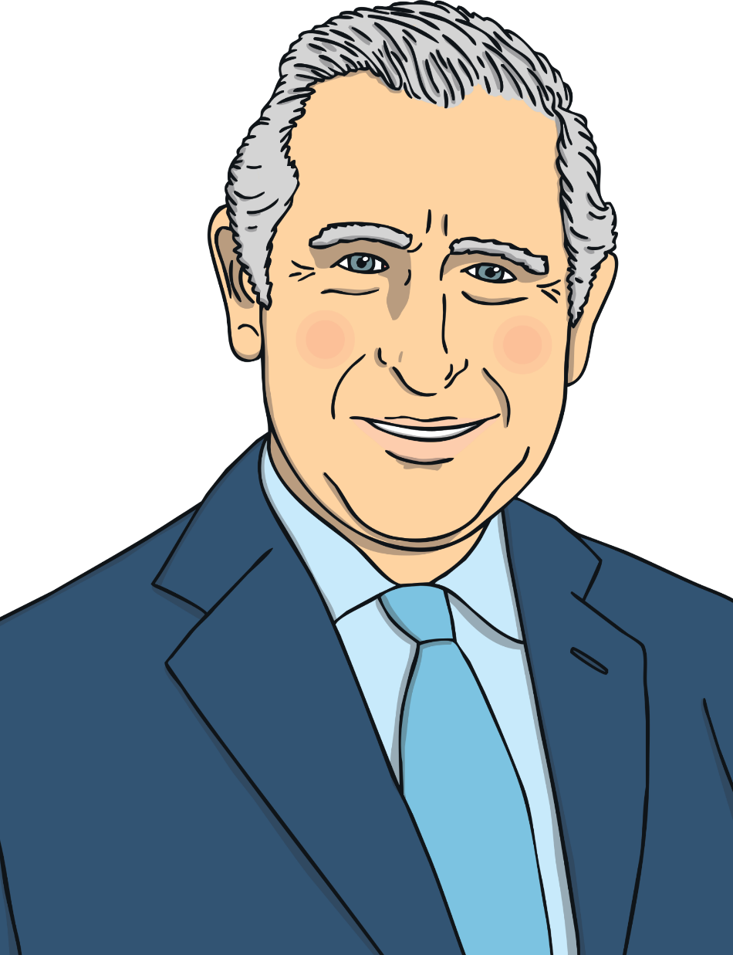
Prince Charles
Prince Charles is the Queen’s oldest son.
His royal title is the Prince of Wales.
His full name is Charles Philip Arthur George.
When the Queen dies, Prince Charles will become king and head of the Royal Family.
Prince Charles has 2 sons: Prince William and Prince Harry.
In 1976, he started the charity ‘The Prince’s Trust’. The charity helps support young people.

Slide 5
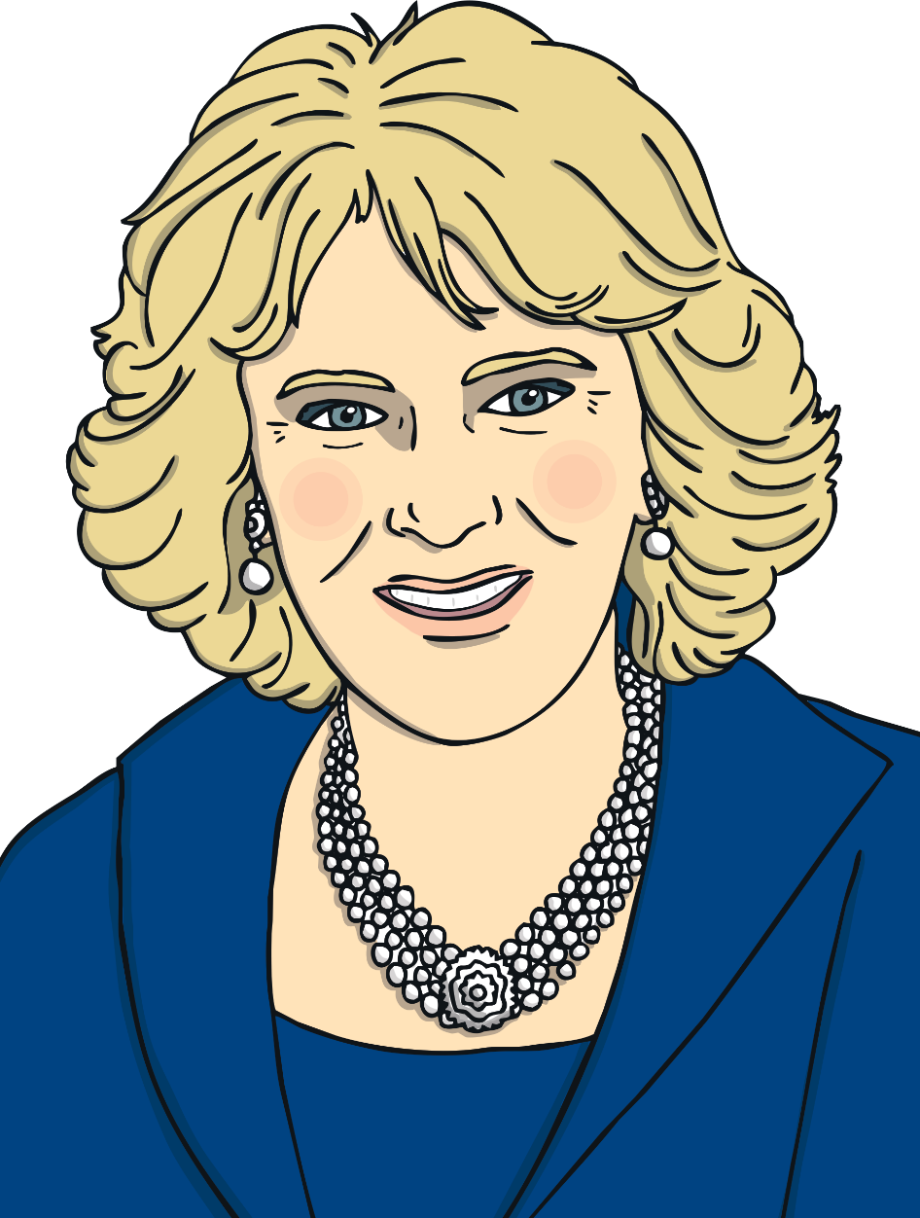
Camilla, Duchess of Cornwall
Camilla is married to Prince Charles.
Her full name is Camilla Rosemary Shand.
When Prince Charles becomes king, she will be known as the queen consort.
Camilla has 2 children of her own and is step-mother to Prince Charles’ sons, Prince William and Prince Harry.

Slide 6
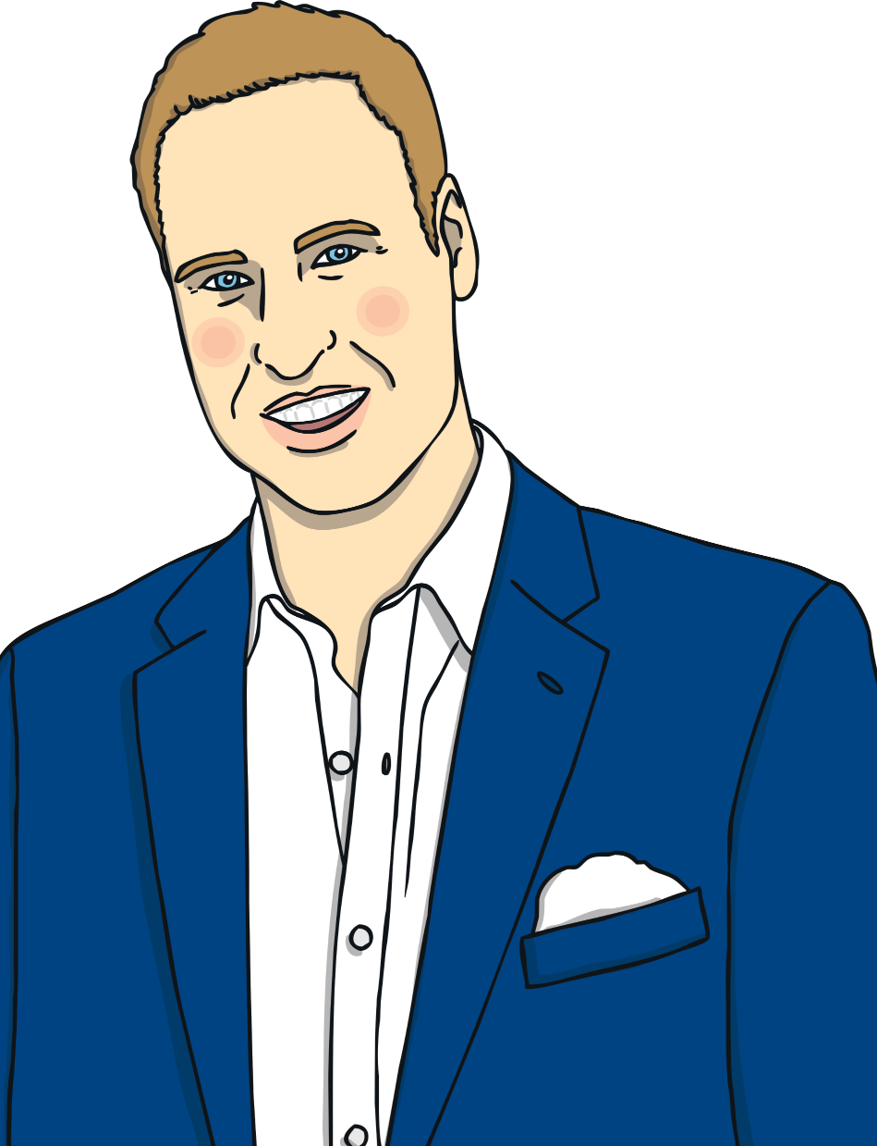
Prince William
Prince William’s full name is William Arthur Philip Louis.
His royal title is Duke of Cambridge.
He is second in line to the throne after his father, Prince Charles.
His mother was Diana, Princess of Wales.
He is married to Catherine, Duchess of Cambridge.
Prince William has 3 children: Prince George, Princess Charlotte and Prince Louis.
He used to be an air ambulance pilot.

Slide 7
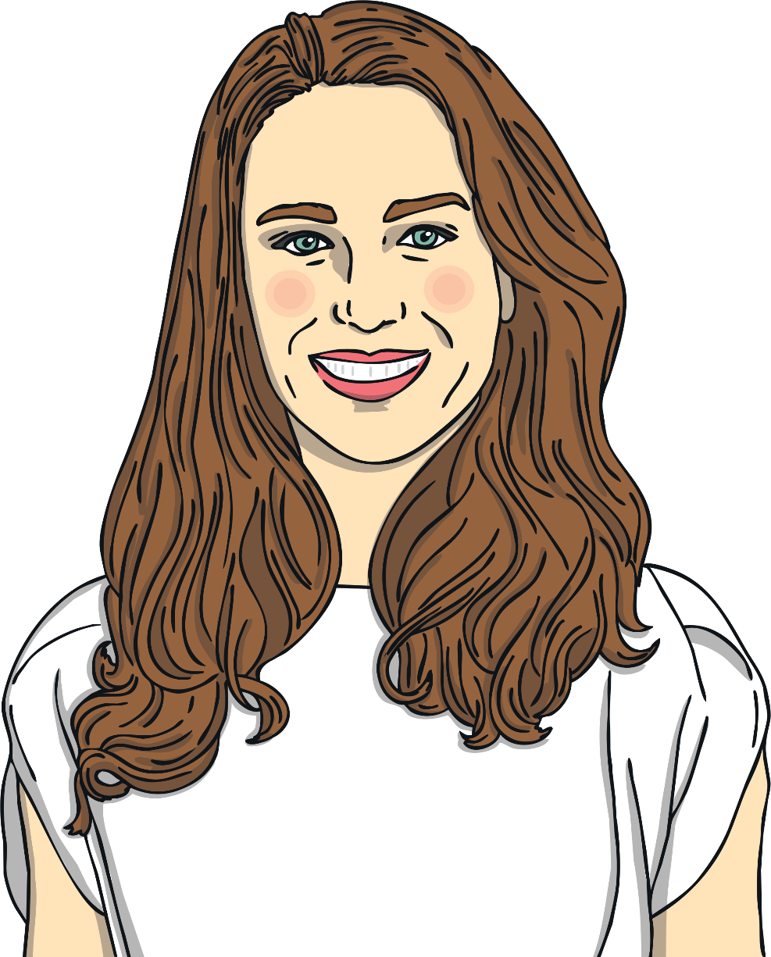
Catherine, Duchess of Cambridge
Catherine’s full name is Catherine Elizabeth Middleton.
Catherine is sometimes known as Kate.
Her royal title is Duchess of Cambridge.
She is married to Prince William.
She is the mother of Prince George, Princess Charlotte and Prince Louis.
When Prince William becomes king, Kate will become queen consort.

Slide 8
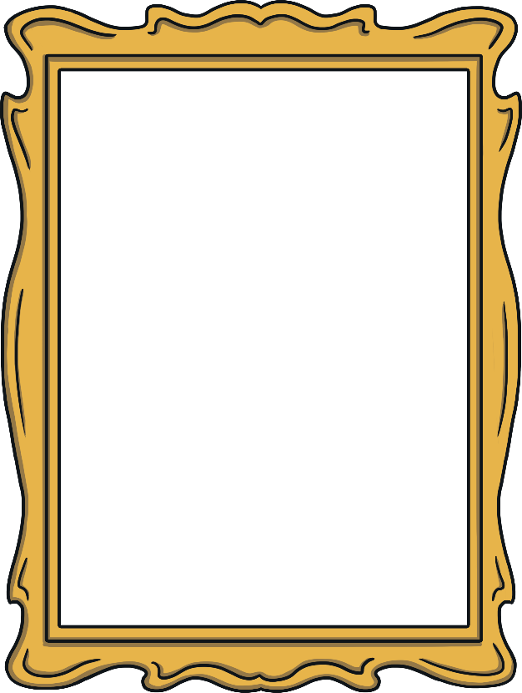
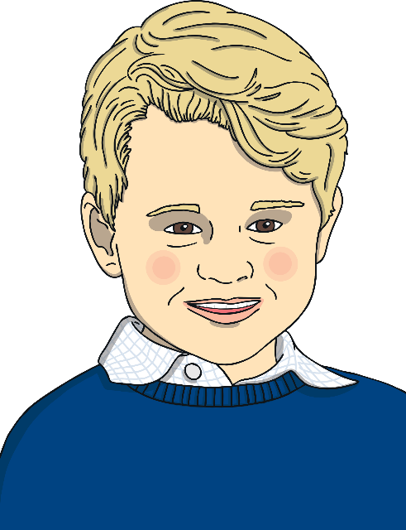
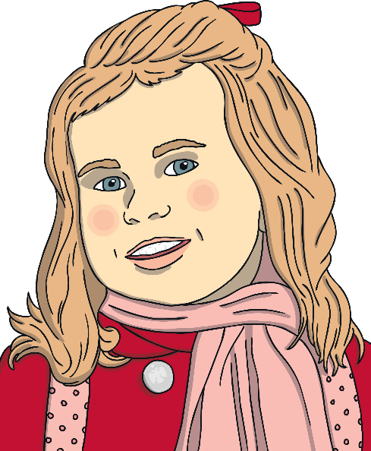
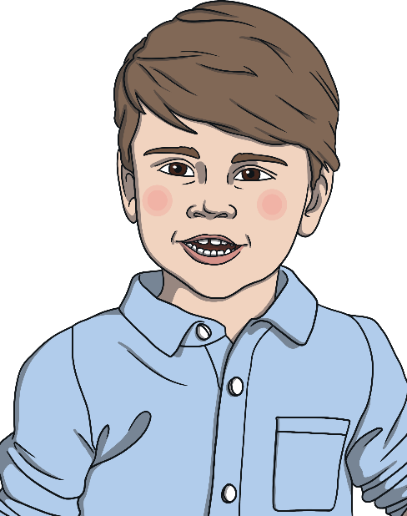
Prince George
Princess Charlotte
Prince Louis
After his father, Prince William, Prince George is next in line to the throne.
That makes him 3rd in line.
Princess Charlotte is currently 4th in line for the throne after Prince George.
If Prince George has children, they will take her place in the line and push her further down.
Prince Louis is 5th in line to the throne.
Like Princess Charlotte, if Prince George has children they will push him further down the line.

Slide 9
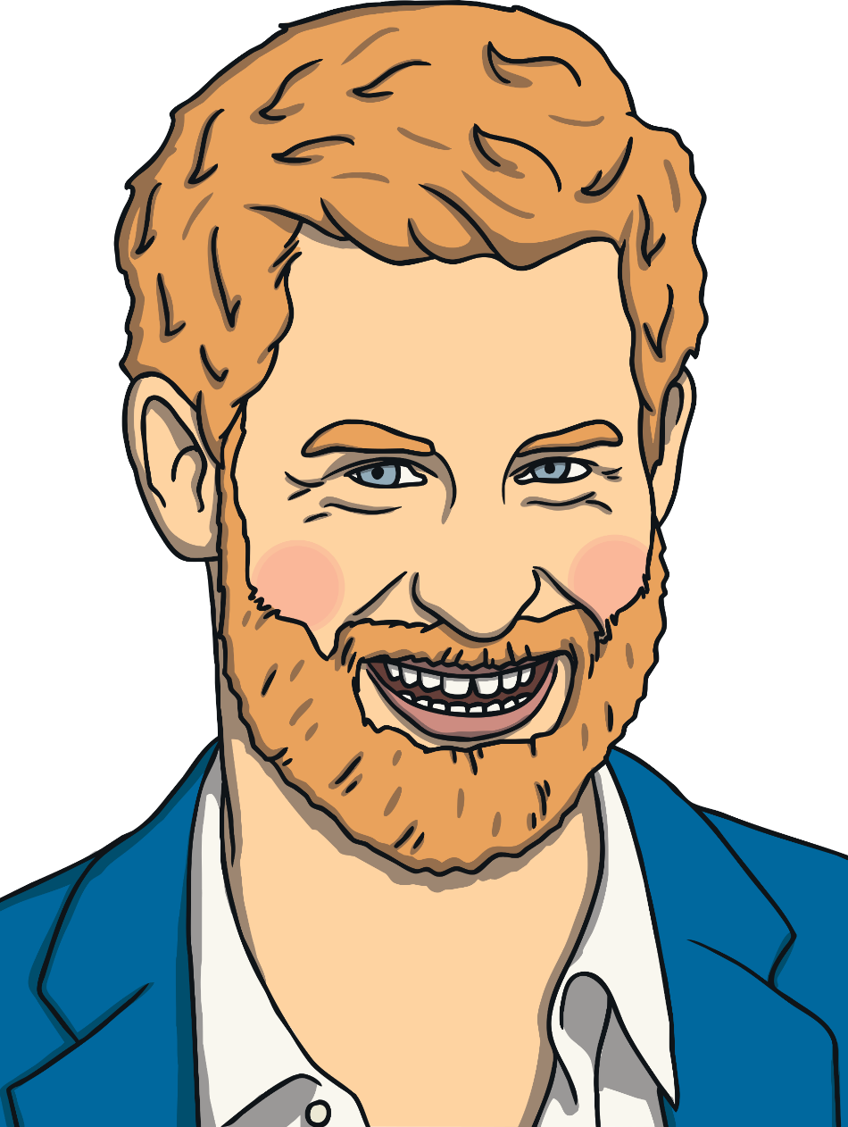
Prince Harry, Duke of Sussex
Prince Harry’s full name is Henry Charles Albert David.
His royal title is Duke of Sussex.
He is married to Meghan, Duchess of Sussex.
He is currently 6th in line to the throne after his father, brother, nephews and niece.
His mother was Diana, Princess of Wales.
He used to be a helicopter pilot in the army.
In 2020, Prince Harry decided not to work as a senior member of the Royal family. This means he will no longer be called 'His Royal Highness' even though he is still a prince.

Slide 10
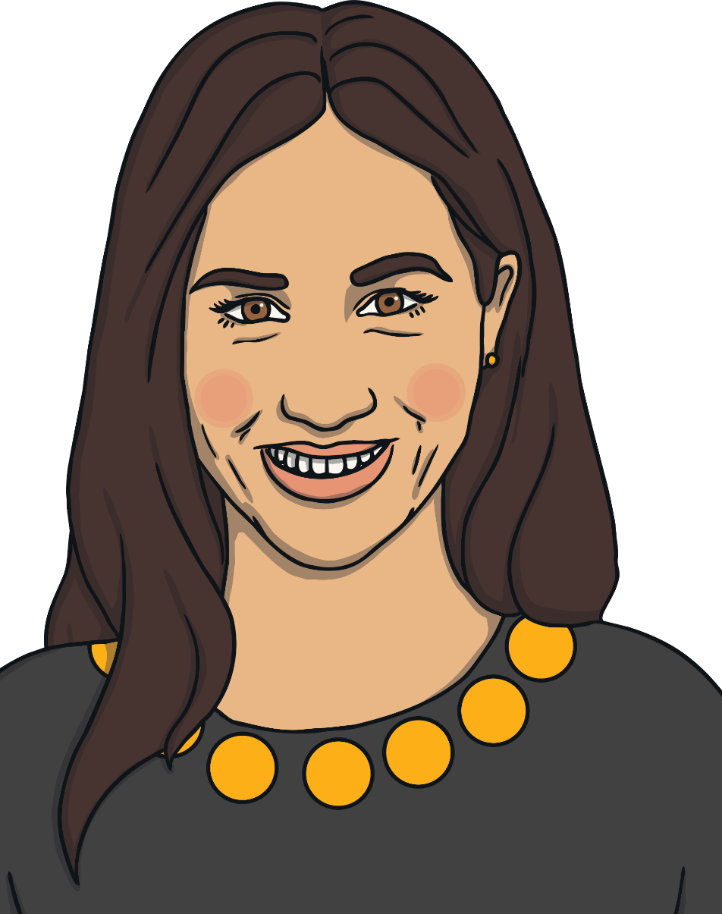
Meghan, Duchess of Sussex
Meghan’s full name is Rachel Meghan Markle.
Her royal title is Duchess of Sussex.
She is married to Prince Harry.
Meghan was born in America but is now a British citizen.
Before becoming part of the royal family she worked as an actress.
Along with Prince Harry, Meghan decided not to work as a member of the Royal family, and to live some of the time in Canada.

Slide 11
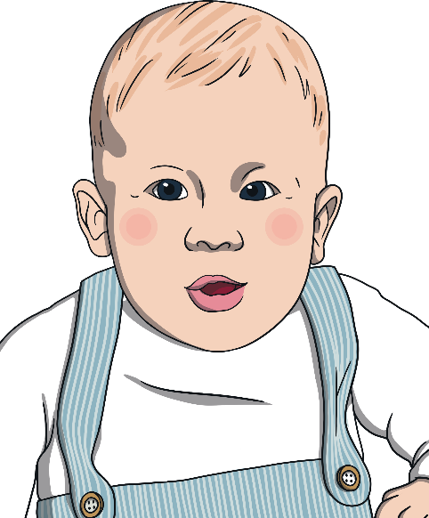
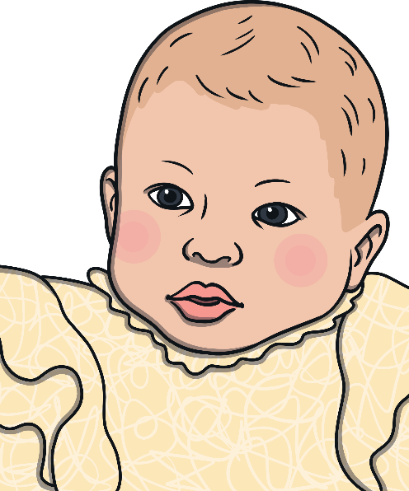
Archie Harrison Mountbatten-Windsor
Lilibet Diana Mountbatten-Windsor
Archie is the son of Prince Harry, Duke of Sussex and Meghan, Duchess of Sussex.
He was born on 6th May 2019.
Archie is 7th in line to the throne after his grandfather, uncle, cousins and father.
Archie does not have a title, such as ‘Prince’, ‘Duke’ or ‘Earl’ and is known as Master Archie Mountbatten-Windsor. This is because his parents want him to grow up as a private citizen.
Lilibet is the daughter of Prince Harry, Duke of Sussex and Meghan, Duchess of Sussex.
She was born on 4th June 2021.
Lilibet is 8th in line to the throne after her grandfather, uncle, cousins and father.
Lilibet is named after Queen Elizabeth II (whose nickname is ‘Lilibet’) and her grandmother, Princess Diana.
Archie and Lilibet do not have titles, such as ‘Prince’, ‘Princess’, ‘Duke’ or ‘Duchess’. This is because their parents want them to grow up as private citizens.

Slide 12
The Royal Family
The Queen
Prince Philip
Princess Anne
Prince Andrew
Prince Edward
Prince Charles
(1st in line to the throne)
Camilla, Duchess of Cornwall
Prince William
(2nd in line to the throne)
Catherine, Duchess of Cambridge
Prince Harry
(6th in line to the throne)
Meghan, Duchess of Sussex
Prince George
(3rd in line to the throne)
Princess Charlotte
(4th in line to the throne)
Prince Louis
(5th in line to the throne)
Archie Mountbatten-Windsor
(7th in line to the throne)
Lilibet Mountbatten-Windsor
(8th in line to the throne)

